Slide 1
FULL STACK DEVELOPMENT COURSE
IRFANSJAH
irfansjah@gmail.com
081293728732

Slide 2
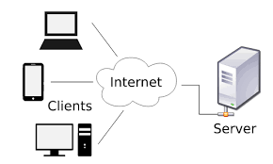
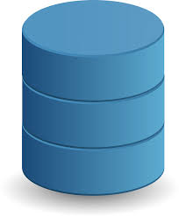
What is FULL STACK DEVELOPMENT ?

Slide 3
FRONT END
BACK END
DATABASE
DESKTOP
WEB APPLICATION
SQL BASED
WEB
MOBILE
SERVICE BASED
NO SQL BASED

Slide 4
WHAT YOU WILL LEARN FROM THIS COURSE
SOFTWARE DEVELOPMENT : TECHNOLOGY STACK MERN
MONGODB / MYSQL / SQLLITE
EXPRESS JS
REACT
NODE JS
PROJECT MANAGEMENT PRACTICE :
FROM IDEA / CONCEPT TO APPLICATION : FIGMA / ADOBE XD
WORKING WITH SOURCE CONTROL : GIT
TASK MANAGEMENT : TRELLO / GITHUB : KANBAN

Slide 5
WHAT YOU WILL LEARN FROM THIS COURSE
FRONT END DEVELOPMENT I:
XML / HTML/XHTML and CSS
Common Text Based Format Used In Software Development Practice : JSON, CSV, ENV
Building Web Application Interface using HTML/XHTML and CSS and Its Interaction using Javascript
Using Popular CSS Framework : Bootstrap
Using Popular Javascript Framework : JQuery
BACK END DEVELOPMENT
Using Node JS to build Server Side Backend Application
Web Application and Service Based Application
Using Express JS to build server based appiication
ORM/ODM using Sequelize and Mongoose

Slide 6
WHAT YOU WILL LEARN FROM THIS COURSE
FRONT END DEVELOPMENT II:
React JS its Usage on Building Web Application Interface
Database System
Between SQL Based and NO SQL Based
Using MongoDB
Using MySQL/SQL Lite

Slide 7
TOOLS WE WILL USE
EXTERNAL TOOLS
IDE :
VISUAL STUDIO CODE,
ANDROID STUDIO
UI DESIGN :
FIGMA
ADOBE XD
WEB SERVER :
NGINX
SOURCE CONTROL : GIT
GITHUB ACCOUNT
POSTMAN
WEB BROWSER
NODEJS
YARN
GITHUB
TRELLO
FIGMA

